Slide 1
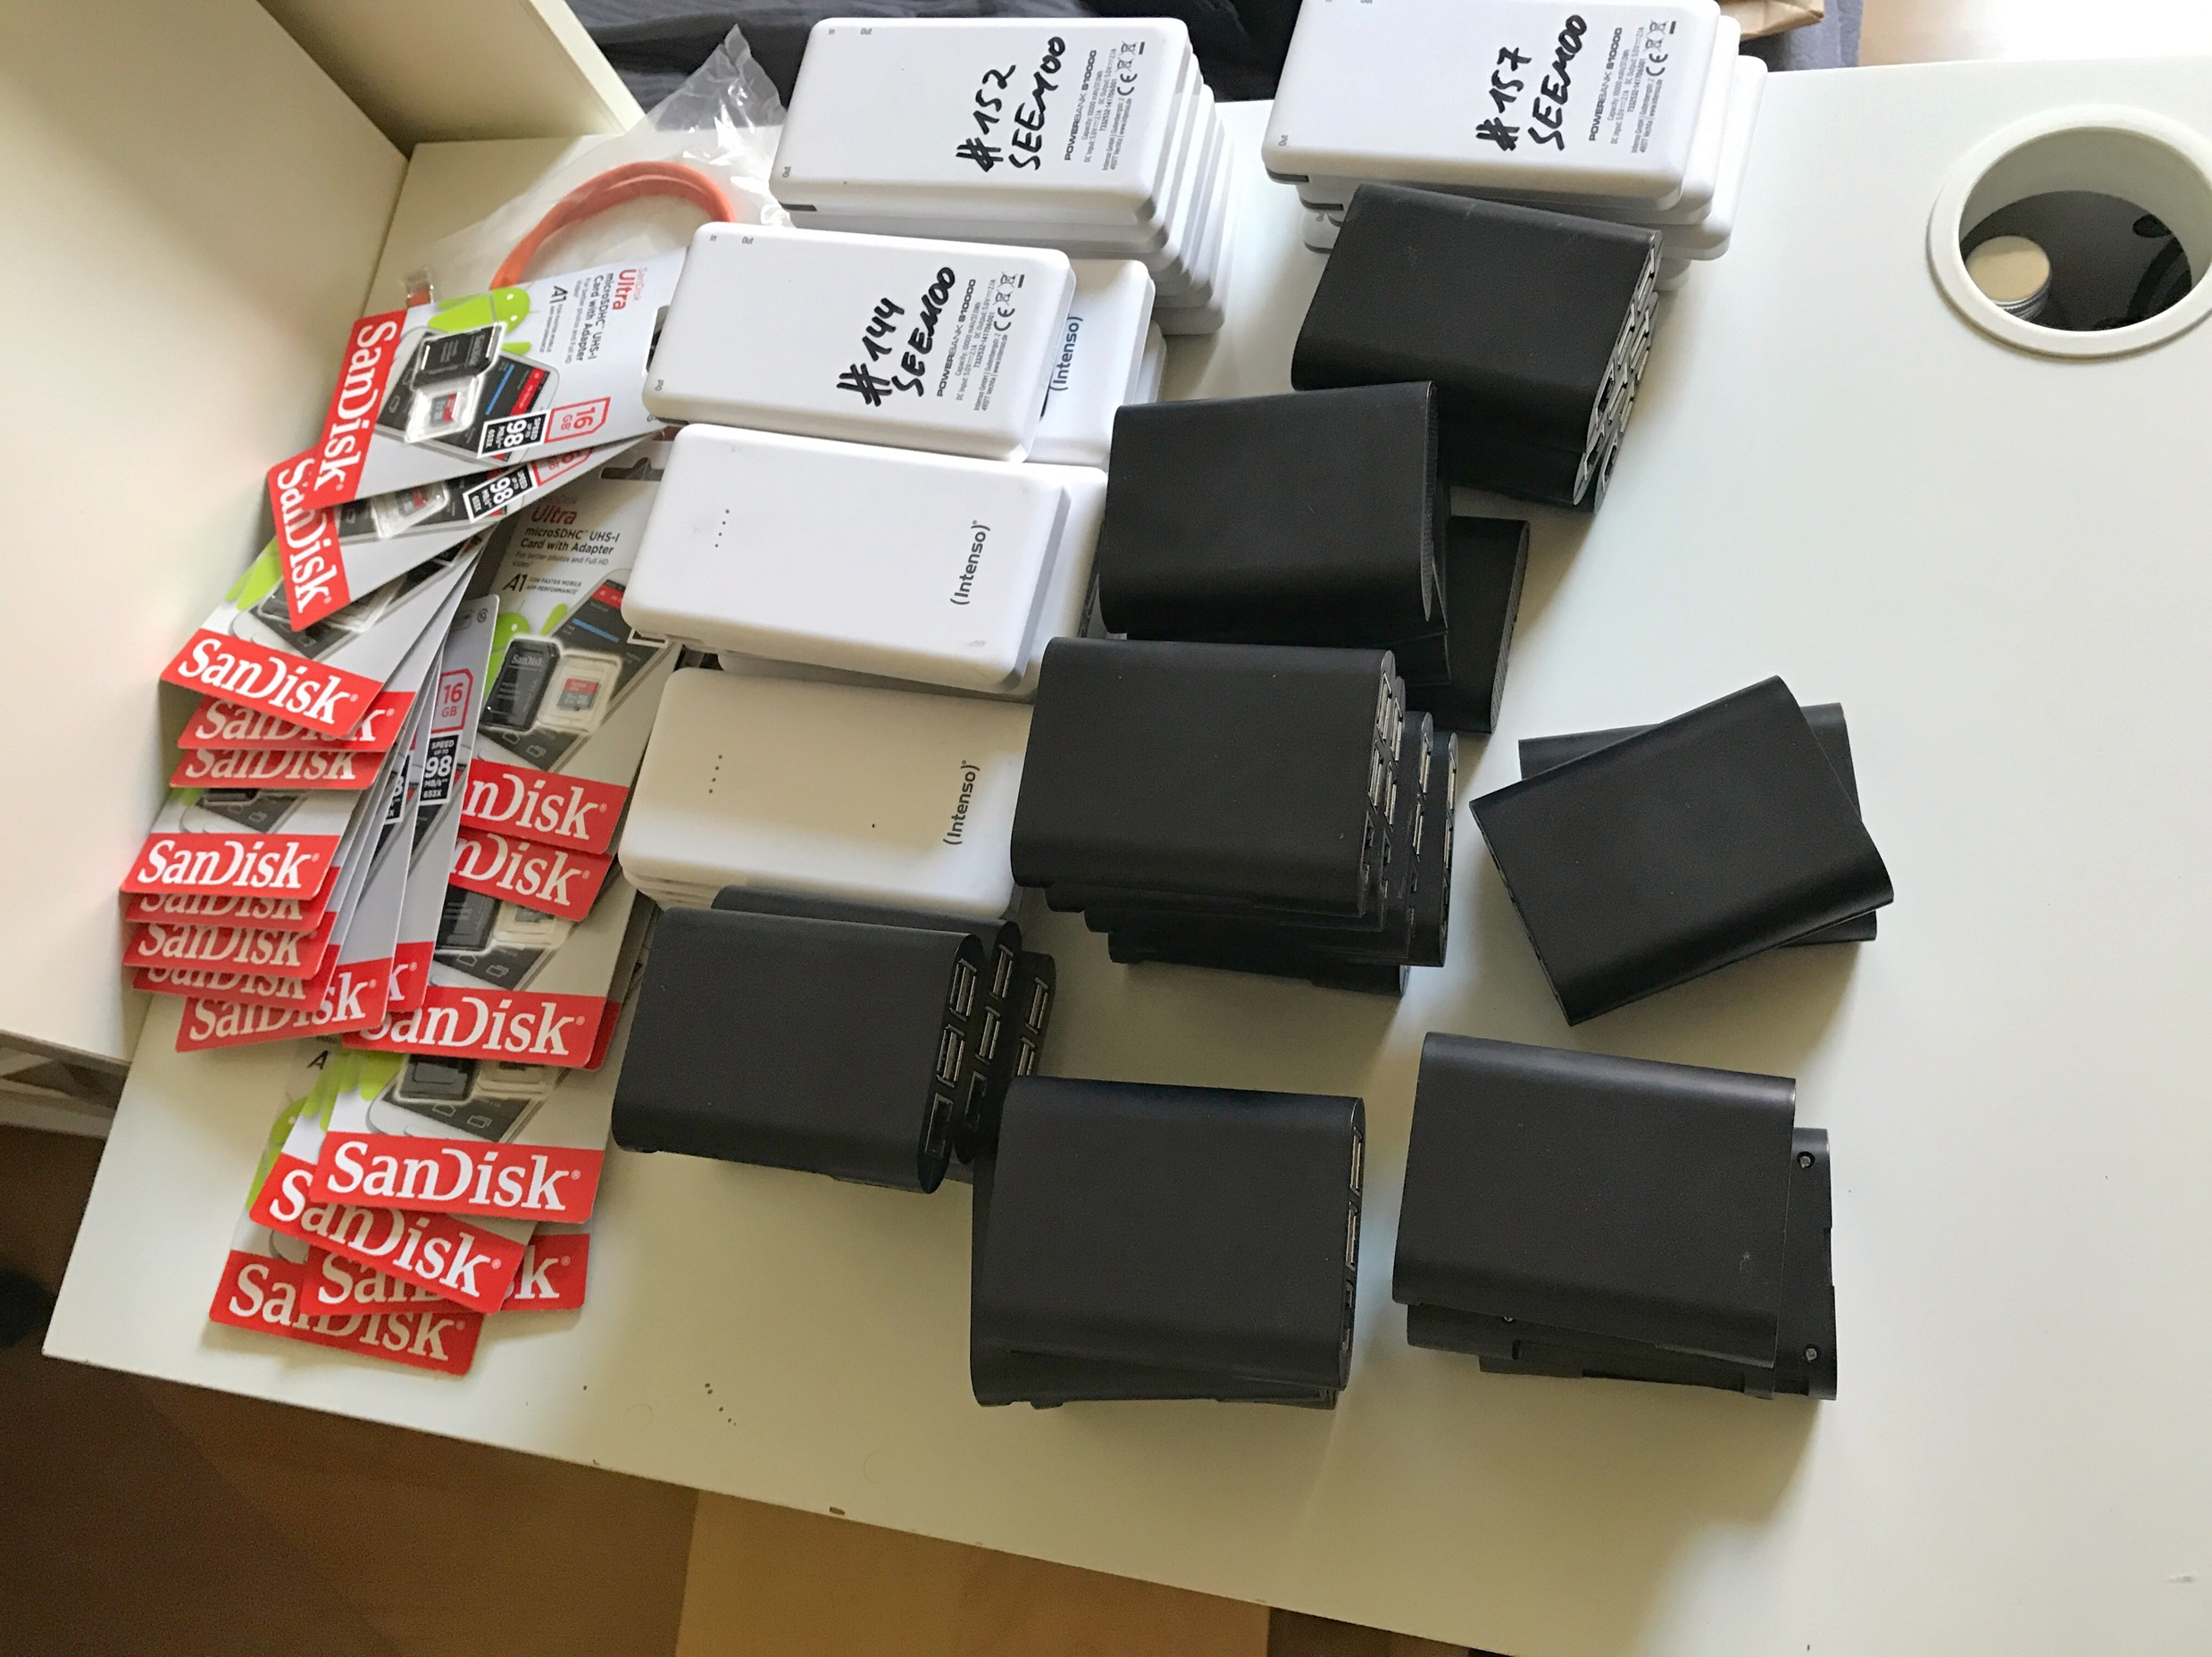
NEAT-TCP
Generation of TCP Congestion Control through NeuroEvolution of augmenting
Topologies for wireless multi-hop networks &
Practical Evaluation of NEAT-TCP on a Wireless Testbed

Slide 2
Outline
Contributions
Background
NEAT-TCP
Evaluation of NEAT-TCP in ns-3
Port of NEAT-TCP to Linux
Building the Testbed
Testbed Locations
Evaluation
Conclusion

Slide 3
Contributions
Design, Implementation and Evaluation of NEAT-TCP
Porting of NEAT-TCP from ns-3 to Linux as a pluggable kernel module.
Planning and building of a testbed with Raspberry Pis.
Evaluation of NEAT-TCP and other Congestion Control algorithms on this testbed in comparison to ns-3 results.

Slide 4
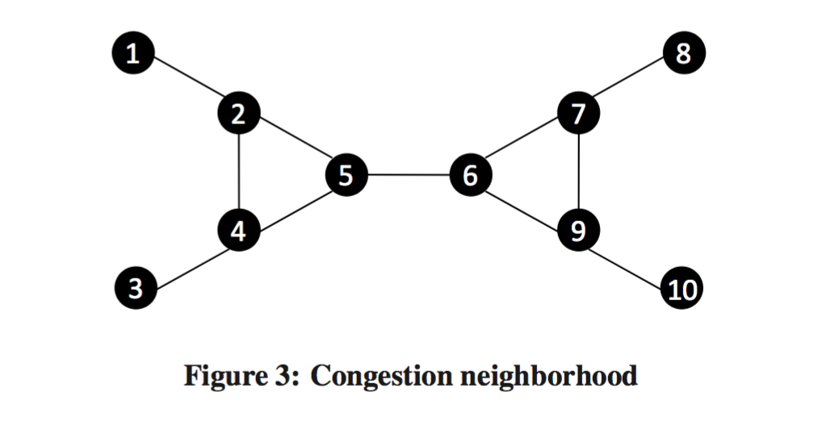
Why is Congestion Control a difficult task in multi-hop WMNs?
CC is triggered because of wrong assumption
Congestion depends not only on a single node, but is a neighborhood phenomenon. (2 hop range)
[1]

Slide 5
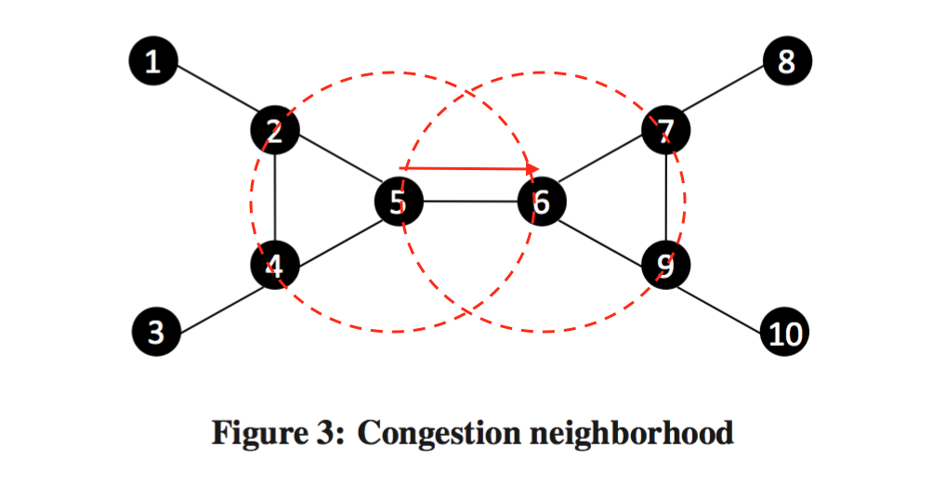
Why is Congestion Control a difficult task in multi-hop WMNs?
Congestion depends not only on a single node, but is a neighborhood phenomenon. (2 hop range)
[1]
Notes:
RTS/CTS

Slide 6
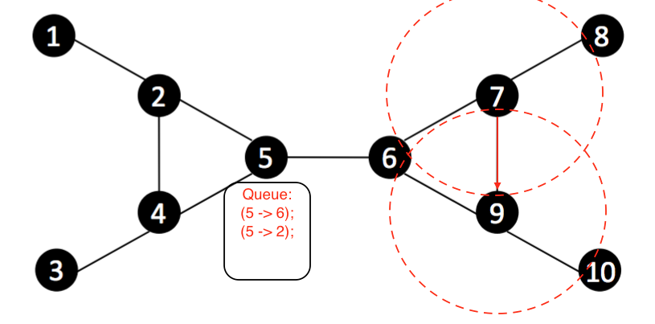
Challenges of TCP Congestion Control in Wireless Mesh networks
Congestion is a neighborhood phenomenon.
RTS/CTS -> Head of line blocking effect.
[1]
[1]

Slide 7
Neural Networks (1)
McCulloch-Pitts Neuron Model:
[2]

Slide 8
Neural Networks (2)
Feed-Forward Neural Network:

Slide 9
NEAT
NeuroEvolution of Augmenting Topologies
Kenneth O. Stanley and Risto Miikkulainen (2002)
Genetic algorithm (evolution)
Prominent in machine learning for games
For example: MarI/O
NEAT evolves NNs that play and finish Super Mario levels.

Slide 10
NEAT – Mutations
- Four different mutations:
- Link Weight Mutation
- Add Link Mutation
0
1
0
0

Slide 11
NEAT – Mutations
- Four different mutations:
- Switch Link Mutation
- Add Node Mutation
1
0.32
0.32

Slide 12
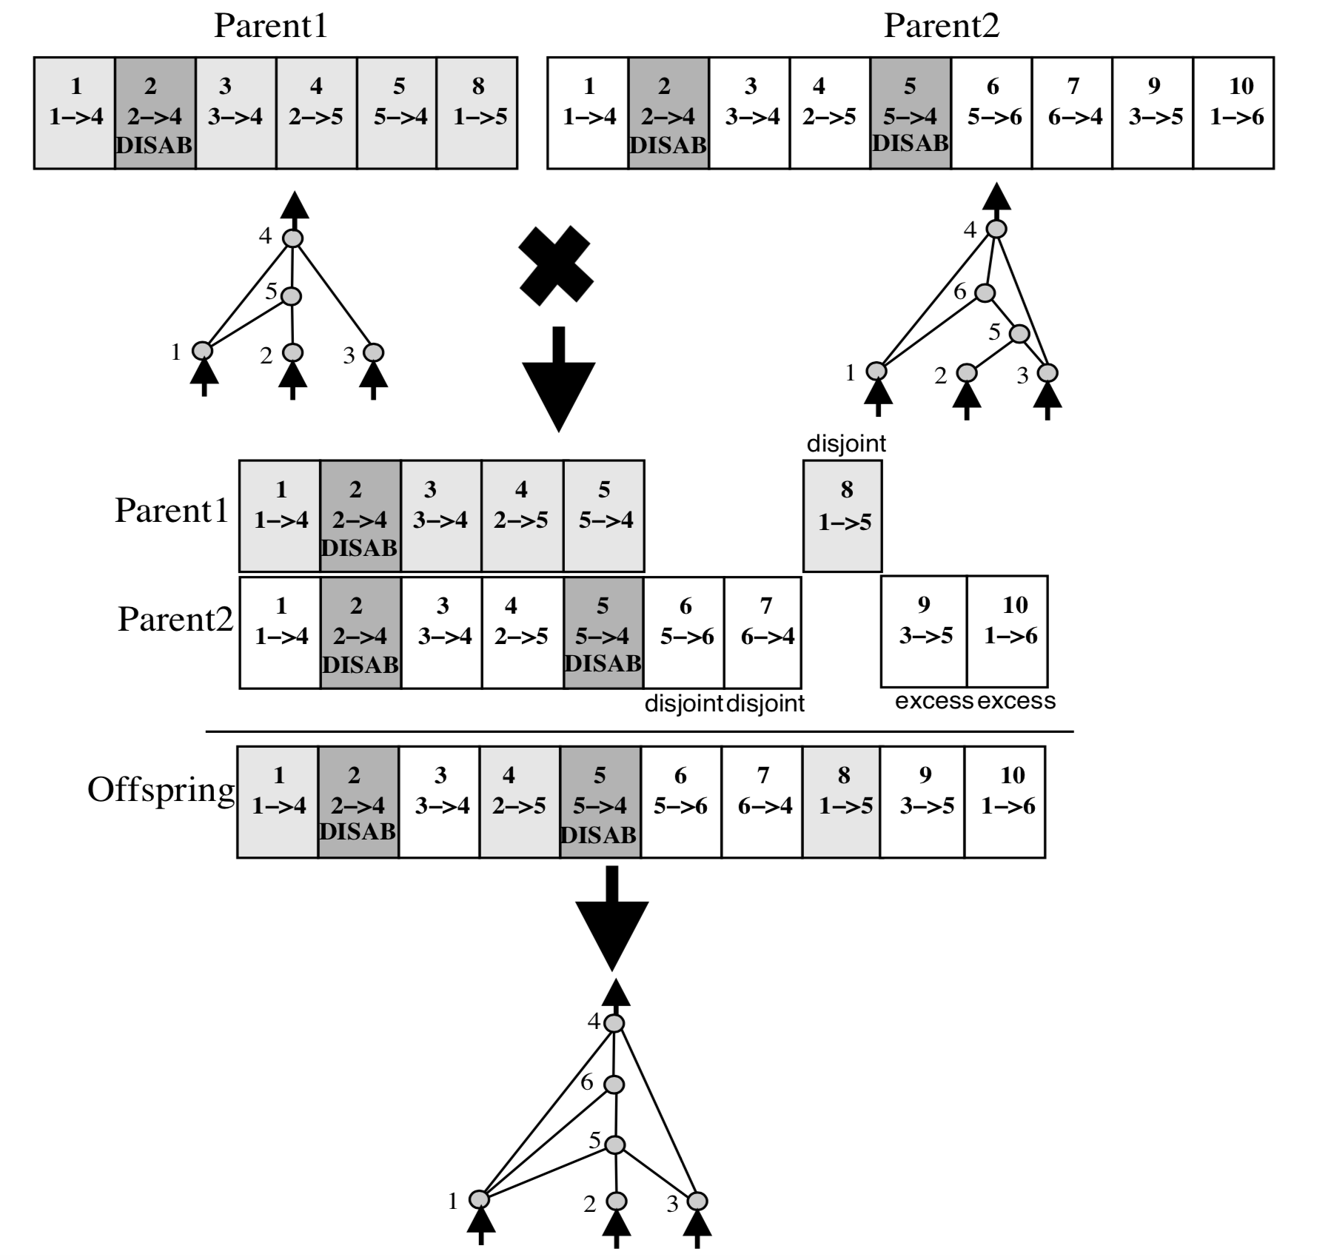
NEAT – Mating/Speciation
[4]
Notes:
Genetic Encoding
Allows for mating/crossover
Easy Speciation-> Compatibility function > how similar

Slide 13
NEAT – Iteration

Slide 14
NEAT-TCP

Slide 15
NEAT-TCP (2)
Initial NN:
Parameters:
Recurrent Probability: 5%
Mutate Link Probability: 80%
Toggle Link Probability: 10%
Add Node Probability: 1%
Add Link Probability: 30%
Population Size: 500 Organisms
Dropoff Age: 15
Epochs: 100

Slide 16
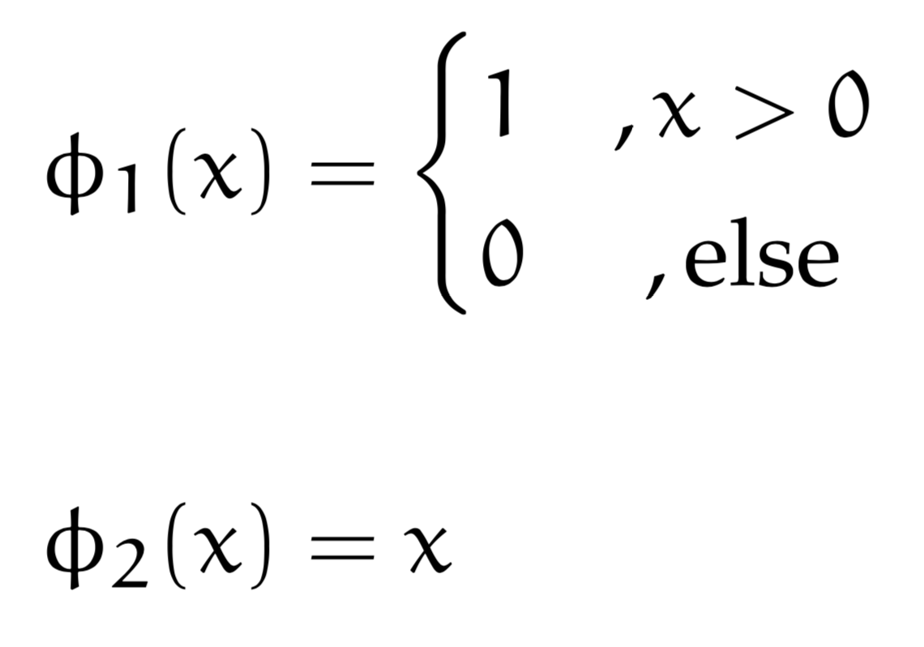
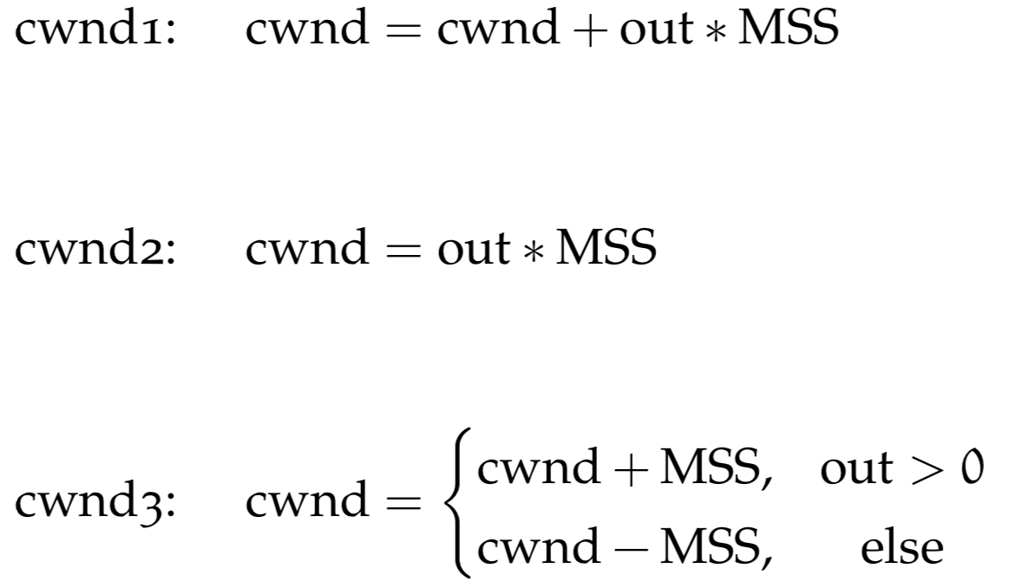
NEAT-TCP (3)
Activation Functions:

Slide 17
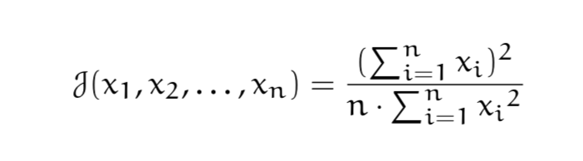
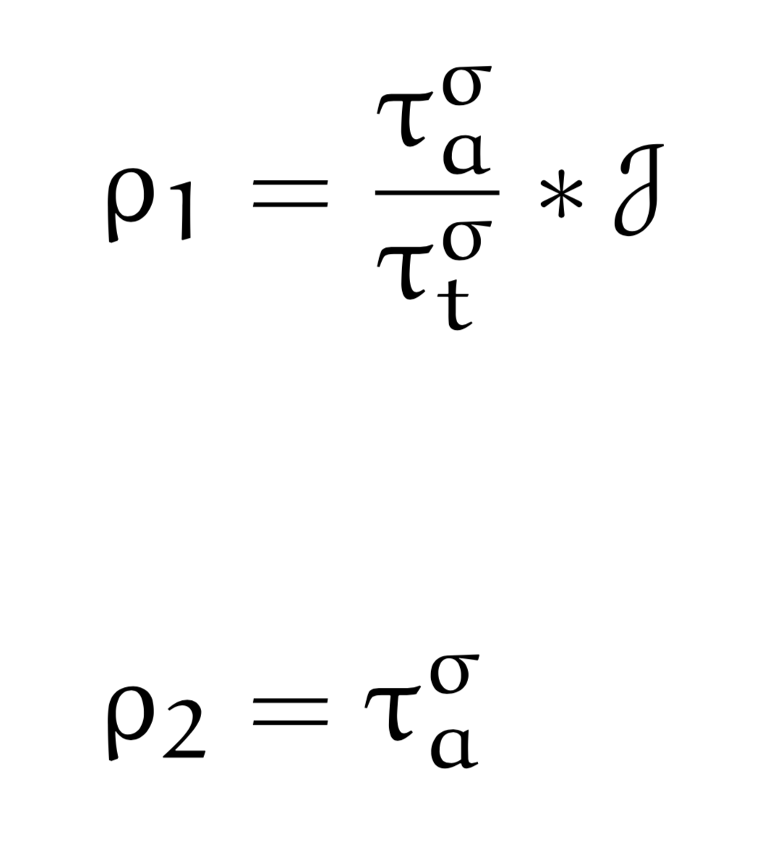
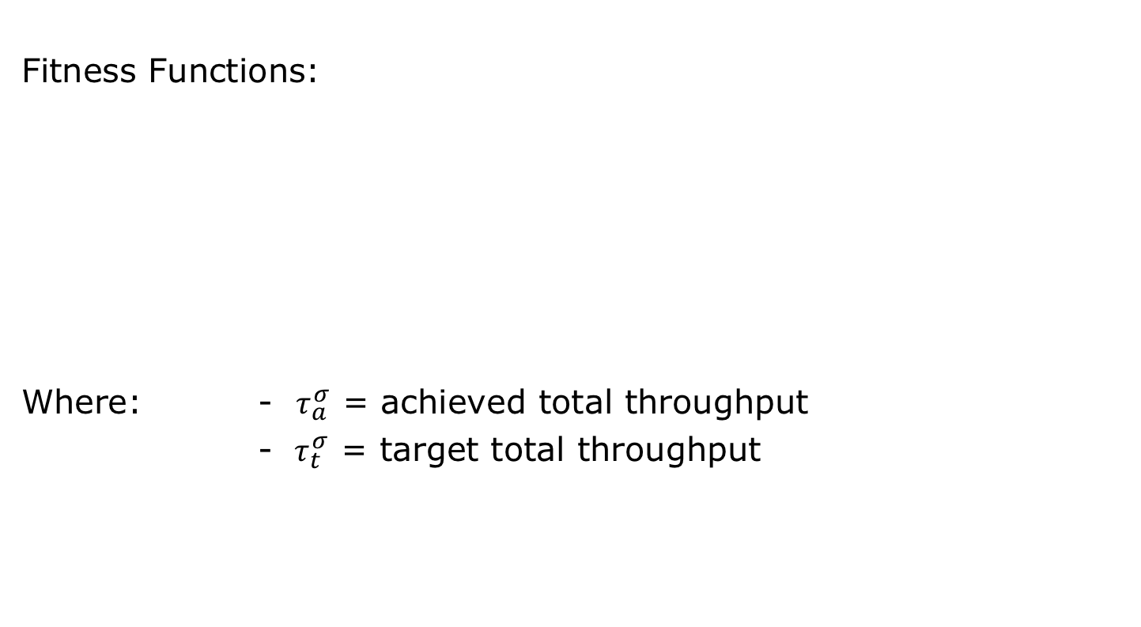
NEAT-TCP (4)
Fitness Functions:
Where: - $τ_{a}^{σ}$ = achieved total throughput
-$τ_{t}^{σ}$ = target total throughput
Jain‘s fairness index

Slide 18
NEAT-TCP (5)
Time Points of Evaluation
PktAcked:
Every time a packet is acknowledged, the NN is evaluated and the cwnd is changed accordingly
Increase Window:
Every time New Reno would increase the cwnd, the NN is evaluated and the cwnd is changed accordingly

Slide 19
Evaluation - Experimental Setup

Slide 20
Evaluation - Throughput

Slide 21
Evaluation – Mean Delay

Slide 22
Evaluation – Packet Loss

Slide 23
Evaluation – Fairness

Slide 24
Pluggable Kernel Module
Mandatory functions:
.ssthresh
.cong_avoid
Additional functions:
.init
.cwnd_event
.undo_cwnd
.in_ack_event
tcp_neat_eval
Notes:
Cwnd_event -> CA_EVENT_LOSS
Undo_Cwnd -> connection broken
Pkts_acked -> dup ack

Slide 25
Problems – Kernel Module
Pluggable congestion control kernel modules do not have access to FPUs.

Slide 26
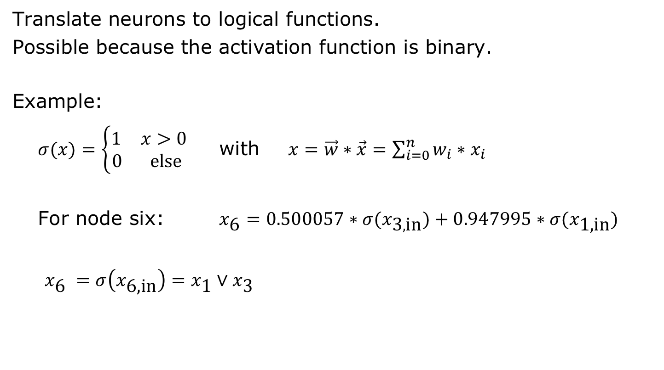
Solution
Translate neurons to logical functions.
Possible because the activation function is binary.
Example:
$σ(x)=\left\{\begin{aligned}\begin{matrix}1 & x>0\end{matrix} \\ \begin{matrix}0 & \text{else} \end{matrix}\end{aligned}\right.$ with $x=\vec{w}∗\vec{x}=\sum_{i=0}^{n}{w_{i}∗x_{i}}$
For node six: $x_{\text{6}}=0.500057∗{σ(x}_{\text{3},\text{in}})+0.947995∗σ(x_{\text{1,}\text{in}})$
$x_{\text{6}} =σ\left(x_{\text{6,}\text{in}}\right)=x_{\text{1}}∨x_{\text{3}}$

Slide 27
Testbed (1)
For each Raspberry Pi:
Install Raspbian
Update & Upgrade
Install iperf3
Enable IP-Forwarding:
In /etc/sysctl.conf -> net.ipv4.ip_forward = 1
Copy compiled congestion control kernel modules
Copy individual scripts
Configure crontab

Slide 28
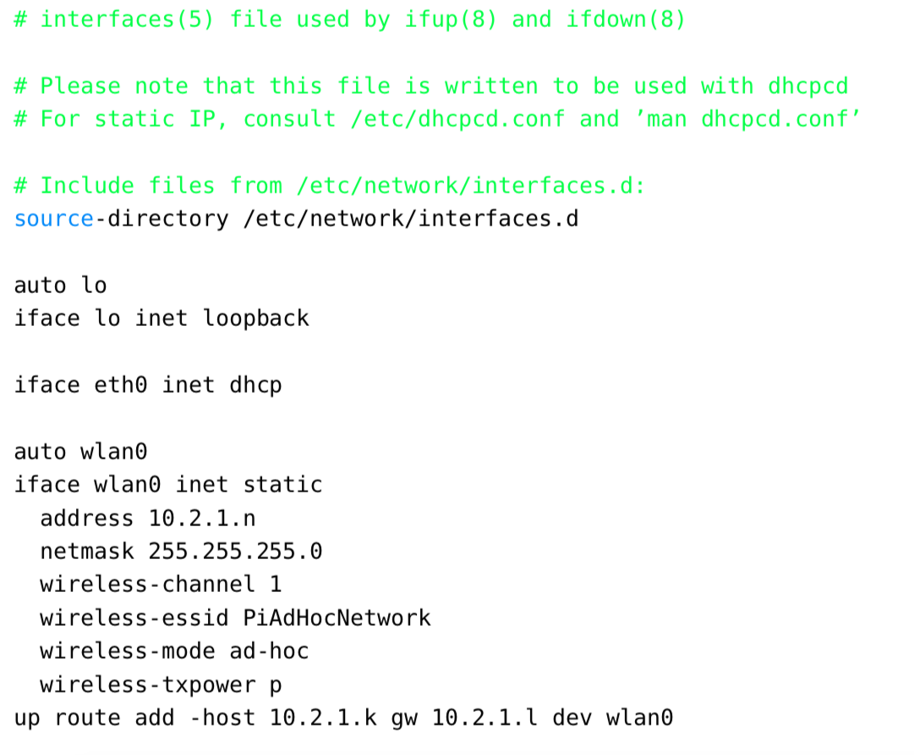
Testbed (2)
RPi interface configuration:

Slide 29
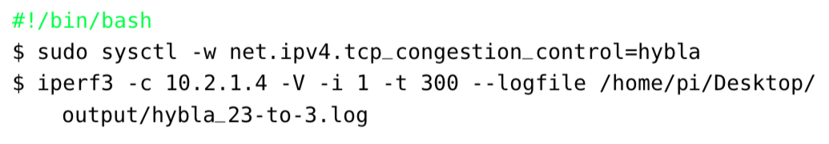
Testbed (3)
Crontab to time scripts
@reboot
15 12 * * *
Experiment script:

Slide 30
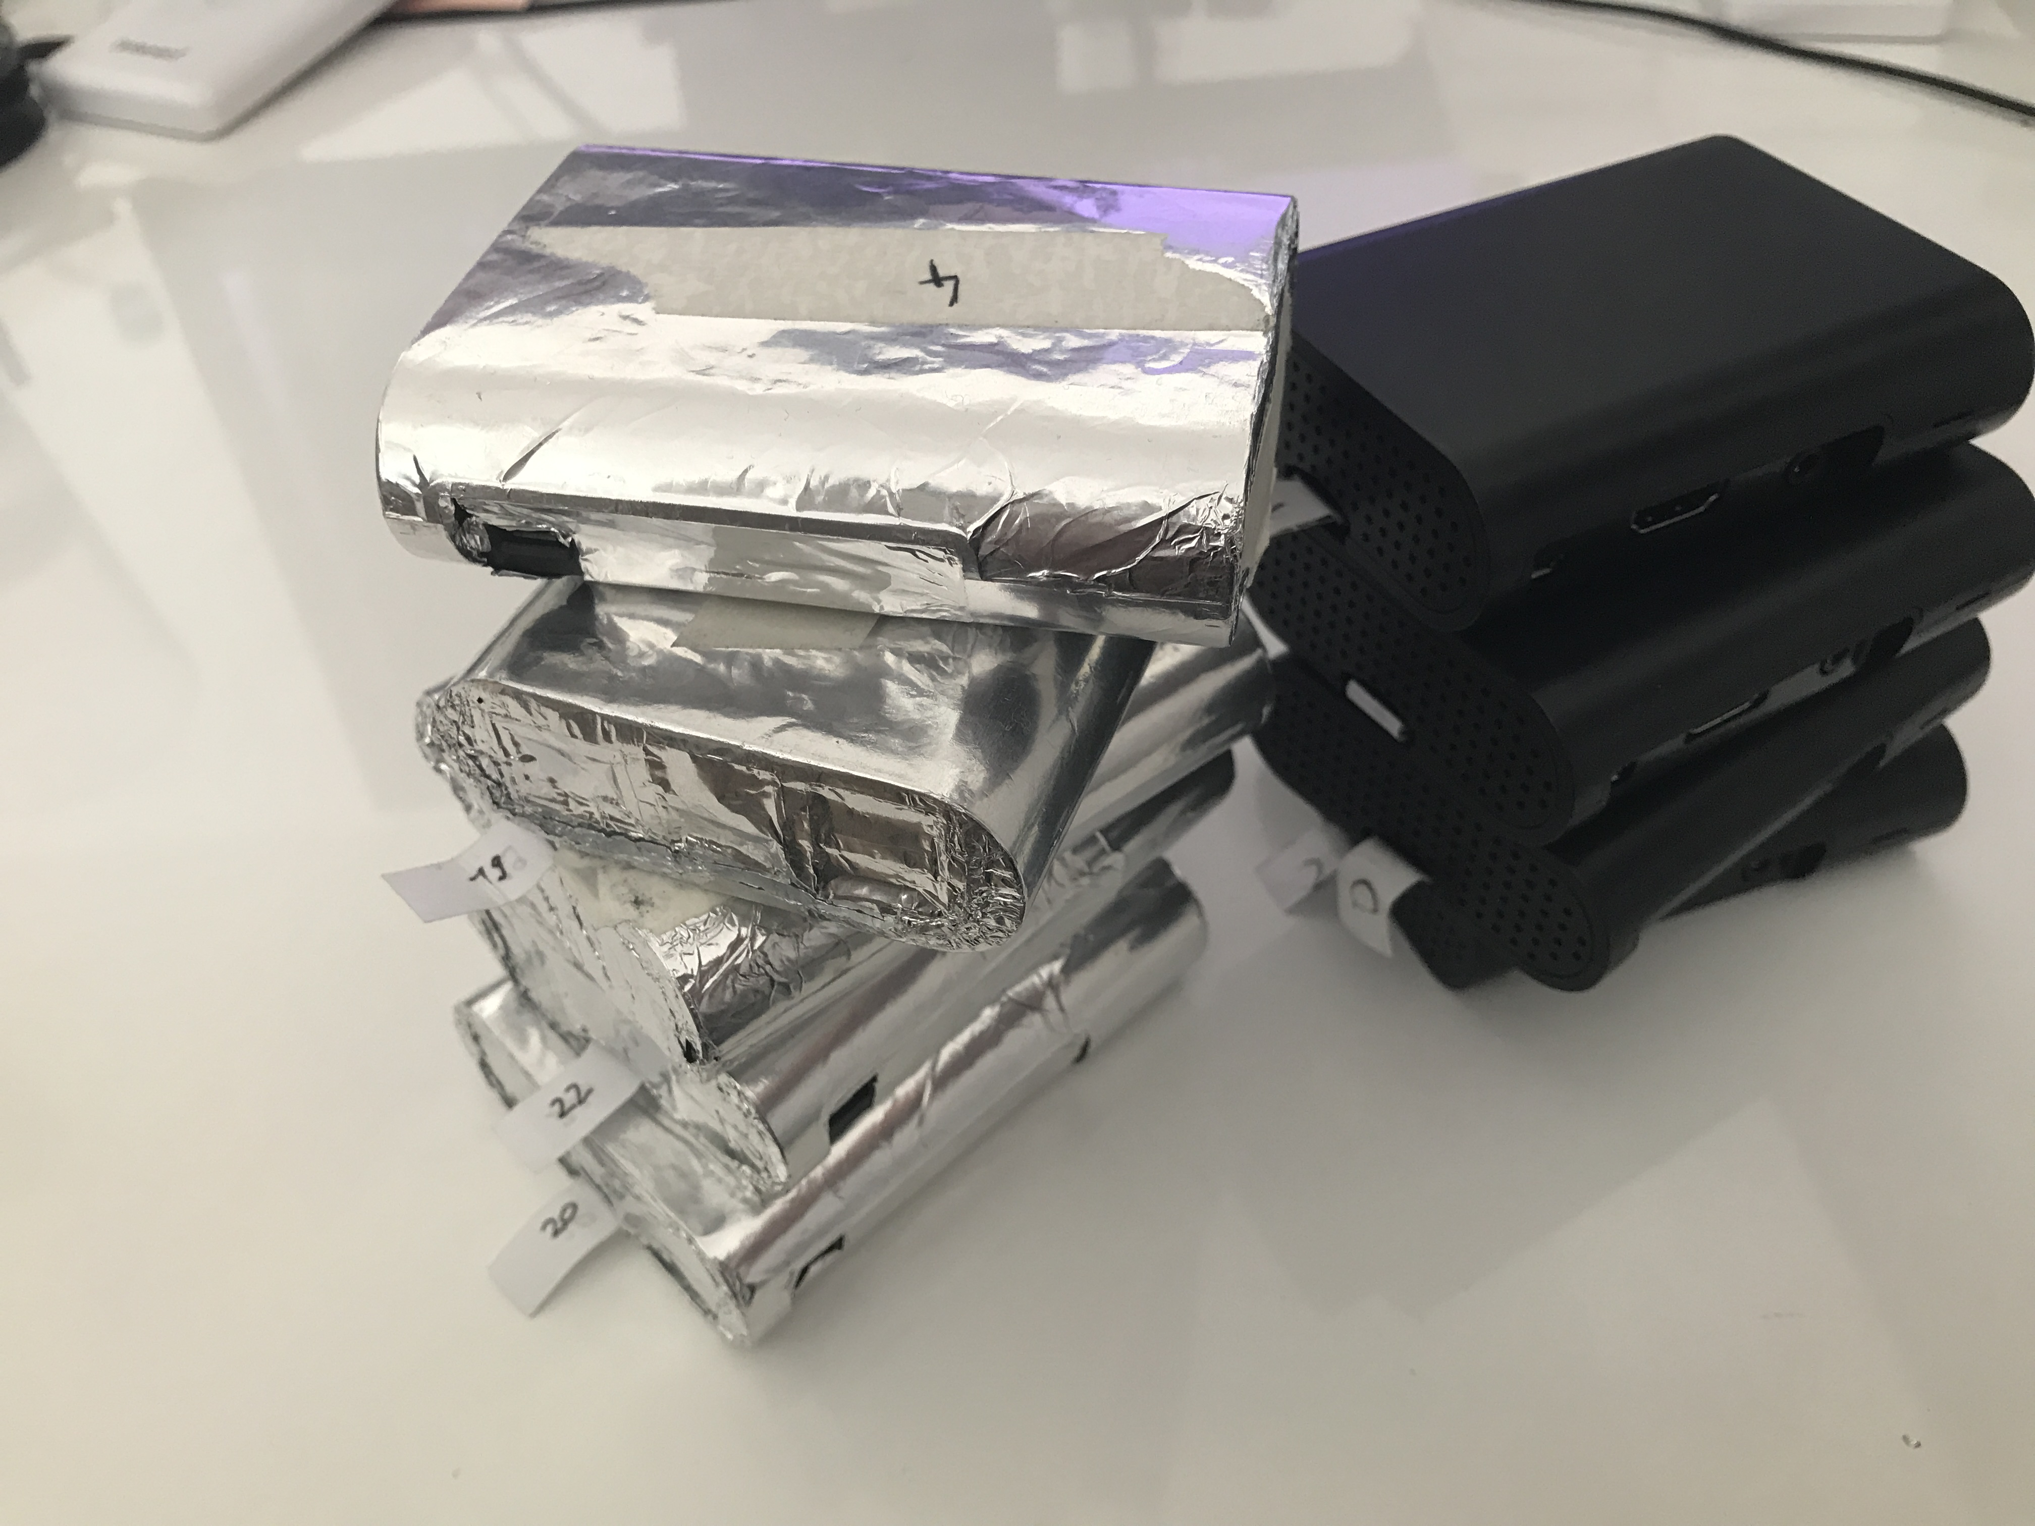
Testbed (4)

Slide 31
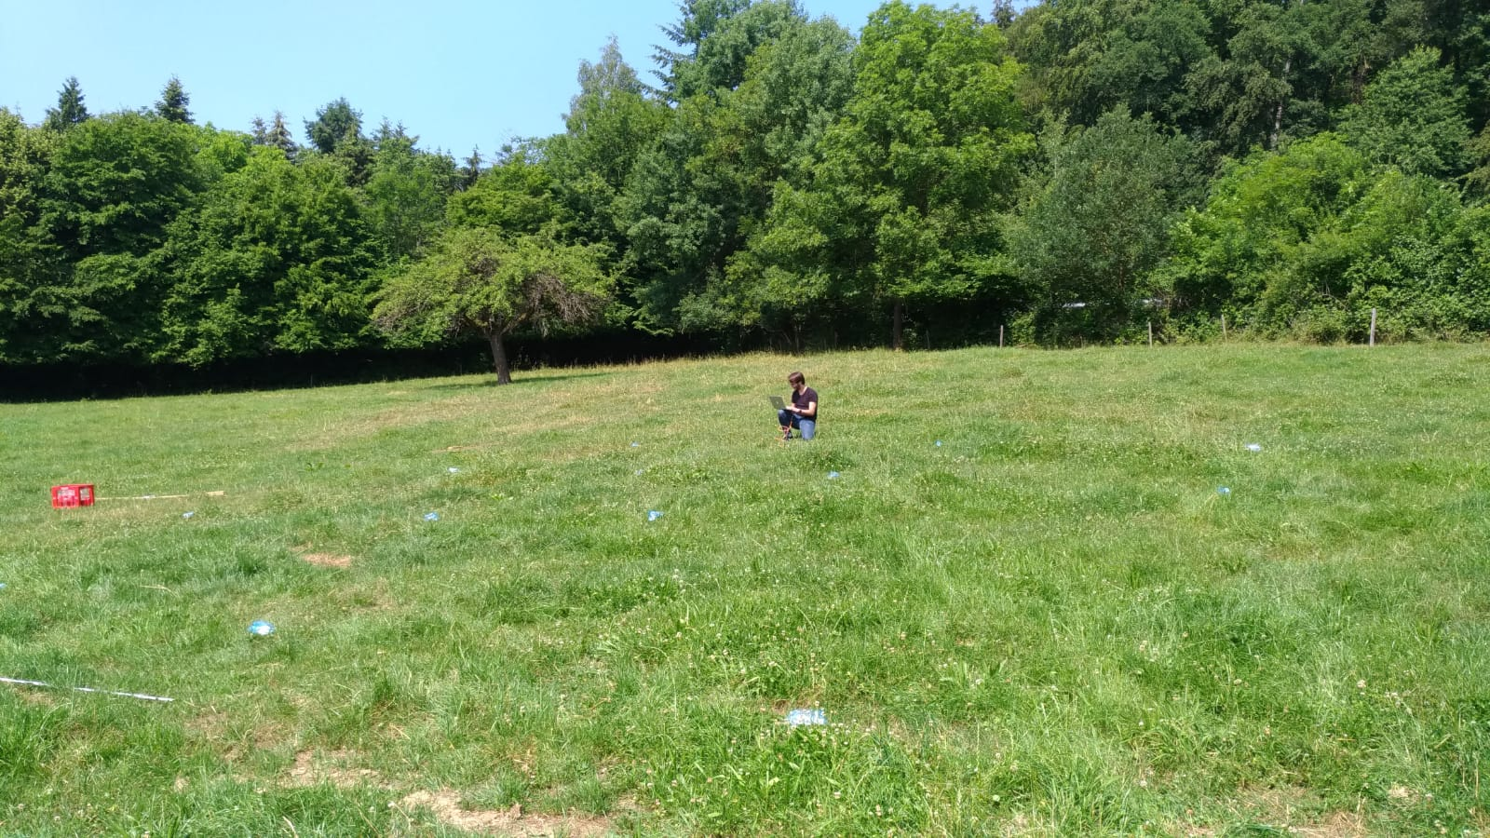
Evaluation – Testsites (1)

Slide 32
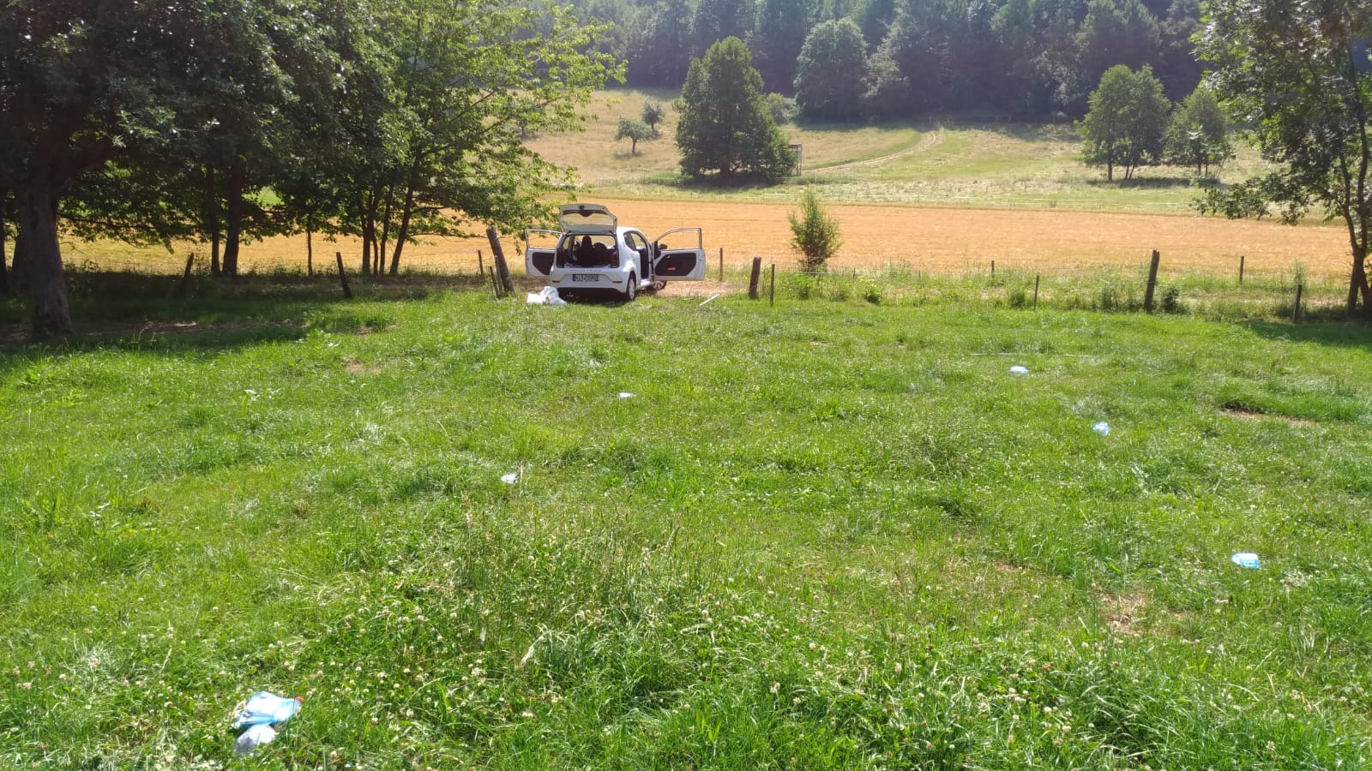
Evaluation – Testsites (2)

Slide 33
Evaluation – Testsites (3)
Free grassland
No interferences
Problems:
On that day 30°C and no clouds
Overheating RPis
Resulting in degraded performance
Lower transmission range

Slide 34
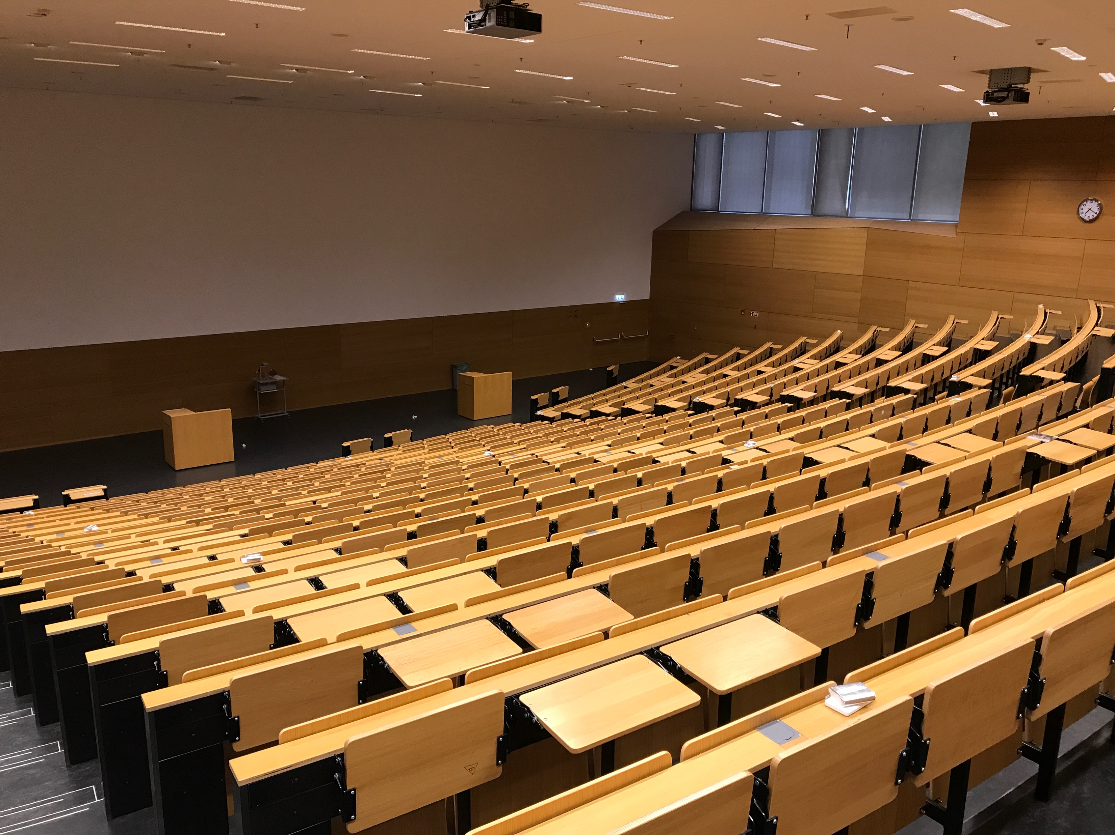
Evaluation – Testsites (4)
L402/1
Weird transmission characteristics
No representative results

Slide 35
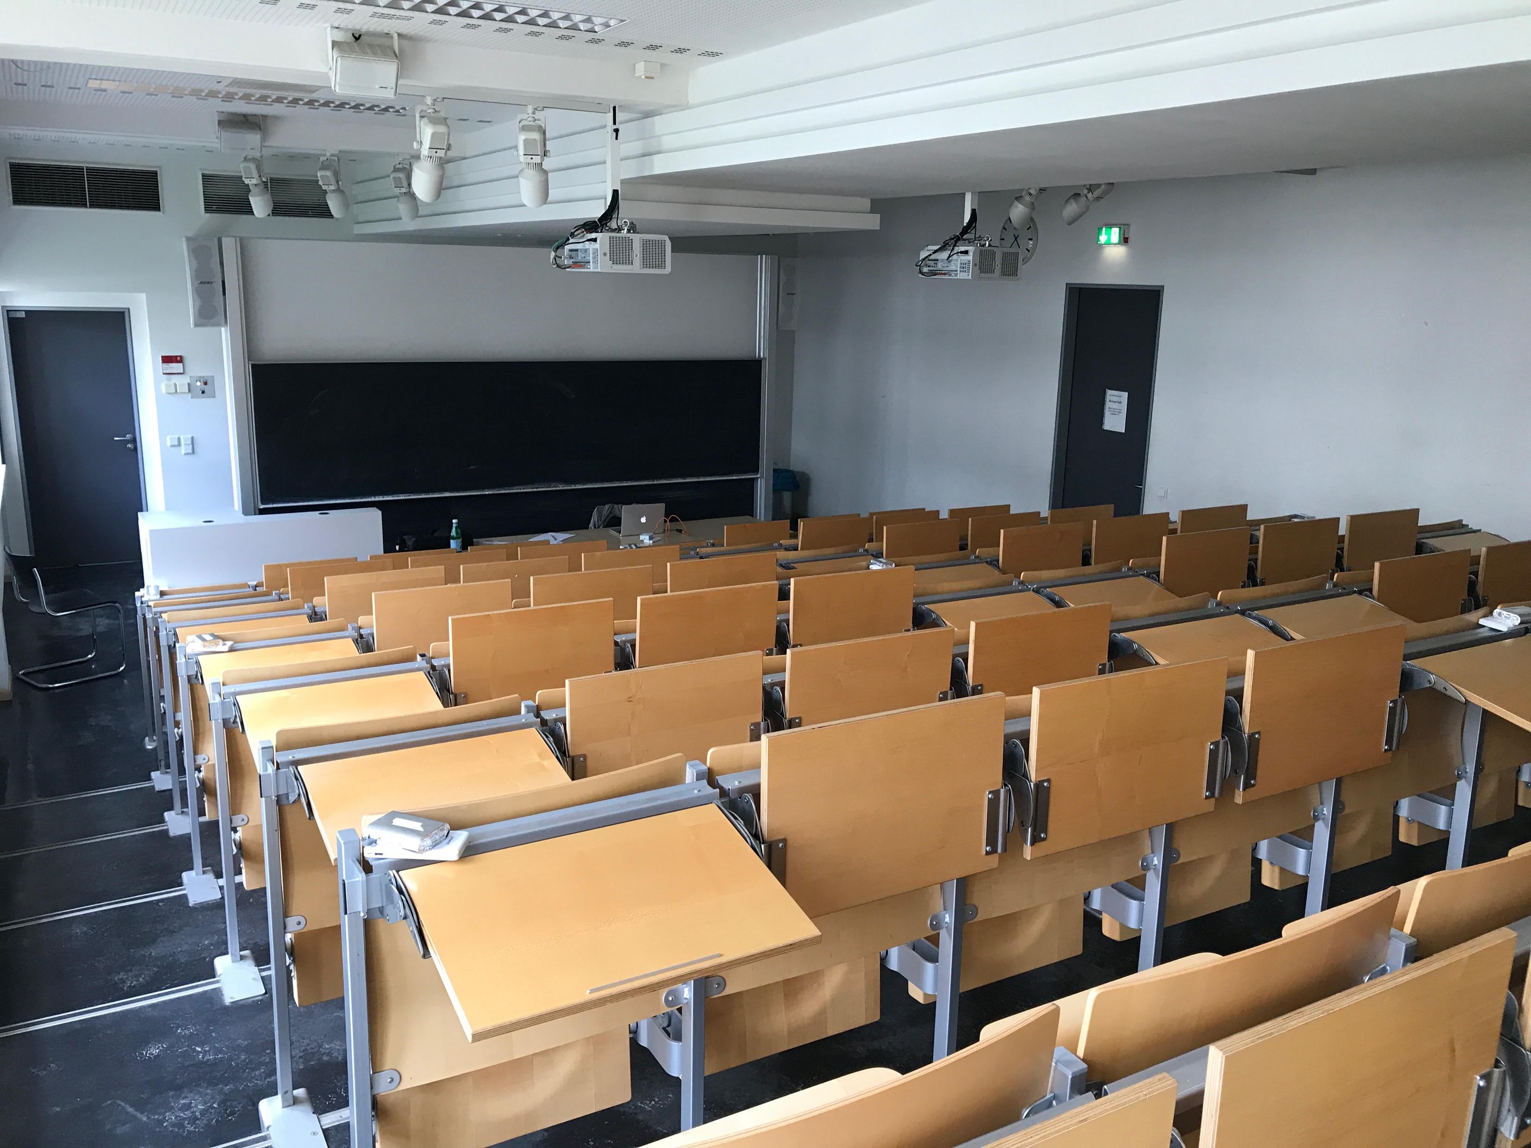
Evaluation – Testsites (5)
S202/110
Only 3x3
Comparable Results
Wireless-power reduced to 1dBm

Slide 36
Evaluation on 3x3

Slide 37
Evaluation on 3x3

Slide 38
Evaluation on 3x3

Slide 39
NEAT-TCP Convergence
Three stop criteria:
Target fitness achieved
Number of epochs reached
Abortion by user
Based on randomness
Generally, with larger population:
Faster (in terms of epochs)
More structural minimal solutions
Higher chance of finding a solution

Slide 40
NEAT-TCP Applicability
Could work in other environments
Wired
Mobile Networks
Etc.
NEAT-TCP works for a range of networks
(generated for 5x5 but has respectable performance in 3x3)
But not tested in different flow configurations
Industrial/Commercial context
Generate a NEAT-TCP before shipping/installation of network

Slide 41
Thank you for your attention!
[1] Sumit Rangwala, Apoorva Jindal, Ki-Young Jang, Konstantinos Psounis, and Ramesh Govindan. “"Understanding congestion control in multi-hop wireless mesh networks".” In: MobiCom 08, Proceedings of the 14th ACM international conference on Mobile computing and networking (2008), pp. 291–302.
[2] Warren McCulloch and William Pitts. “"A logical calculus of the ideas immanent in nervous activity".” In: Bulletin of Mathematical Biophysics (1943), pp. 115–133.
[4] Kenneth O. Stanley and Risto Miikkulainen. “Evolving Neural Networks Through Augmenting Topologies.” In: Evolutionary Computation 10.2 (2002), pp. 99–127. url: http://nn.cs.utexas. edu/?stanley:ec02.

Slide 42
Copyright Notice
This document has been distributed by the contributing authors as a means to ensure timely dissemination of scholarly and technical work on a non-commercial basis. Copyright and all rights therein are maintained by the authors or by other copyright holders, notwithstanding that they have offered their works here electronically.
It is understood that all persons copying this information will adhere to the terms and constraints invoked by each author’s copyright. These works may not be reposted without the explicit permission of the copyright holder.

Slide 43
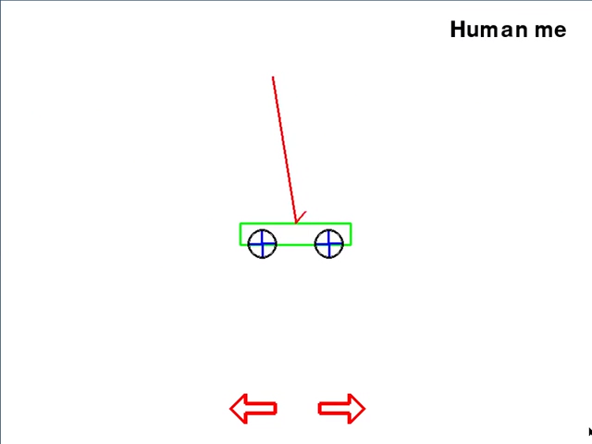
Why these parameters?
Same parameter file used as in double pole balancing on a cart:
[3]
Notes:
Congestion control similar to control technology problems
But Congestion control is distributed
Indirect tinkering

